Slide 1
One-to-many mapping between closely related languages and its influence on second language acquisition
Kristi Pällin
Annekatrin Kaivapalu
Tallinn University
27.9.2013
LCR 2013

Slide 2
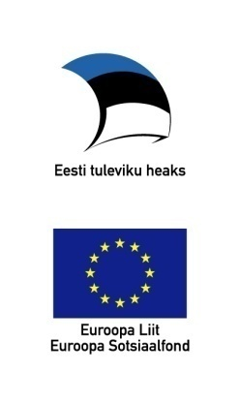
Framework
Projects
Cross-linguistic influence and second language acquisition: corpus-based research (Tallinn University; Estonian Science Foundation ETF8240, 2010-2013)
Corpus study on language-specific and universal features in learner language (Universities of Oulu, Umeå and Tallinn; Riksbanken Jubileumfond)
Notes:
2

Slide 3
Outline
Background to the study: one-to-many mapping
Estonian verb minema ‘to go’ and Finnish verb mennä ‘to go’
Aim and objectives, focus of this presentation
Method
Usage of Finnish verbs mennä ‘to go’ and lähteä ‘to start to go’ in native corpus
Usage of Finnish verbs mennä and lähteä in Estonian subcorpus of ICLFI
Summary and further research
Notes:
3

Slide 4
Mappings between the linguistic phenomena of L1 and L2 in SLA
Structural-contrastive theory
One-to-one mappings the easiest
The most difficult
L2 phenomena that do not exist in L1
One-to-many mappings
Many-to-one mappings
Notes:
4

Slide 5
Closely related synonyms in Finnish: mennä or lähteä?
In Finnish two structurally parallel paradigms:
mennä: menen ‘to go: I go’
lähteä: lähden ‘to start to go, to leave: I start to go, I leave’.
In Estonian one paradigm in complementary distribution:
minema: lähen ‘to go: I go’.
Notes:
5

Slide 6
Comparison of the verb conjugation
 | Estonian minema | Finnish mennä | Finnish lähteä
Active Present | lähen | menen | lähden
Active Imperfect | läksin | menin | lähdin
Active Conditional | läheksin | menisin | lähtisin
Active Imperative | mine | mene | lähde
Active Perfect | läinud | mennyt | lähtenyt
I Infinitive | minna | mennä | lähteä
III Infinitive Ill | minema | menemään | lähtemään
Active I Participle | minev | menevä | lähtevä
Passive Present | minnakse | mennään | lähdetään
Notes:
6

Slide 7
Aim and objectives
The aim of the study
To explore the influence of one-to-many mapping on the acquisition and processing of Finnish as a foreign language
In this presentation: comparison of using mennä- and lähteä-verbs by Estonian learners of Finnish with native speakers
Research questions
How and in what context does the Estonian learner use mennä- and lähteä-verbs?
Whether and how lähteä- and mennä-verb usage vary on proficiency levels A1-C1?
Whether and how learner usage of lähteä- and mennä-verbs differs from the usage in the native Finnish corpus?
Notes:
7

Slide 8
Data
The International Corpus of Learner Finnish (ICLFI) http://www.oulu.fi/hutk/sutvi/oppijankieli/ICLFI/Yleinen/index.html
Estonian subcorpus
Native Finnish corpus http://www.csc.fi/tutkimus/alat/kielitiede
Notes:
8

Slide 9
Token ratio in Estonian subcorpus by text type
CEFR level | story | description | report | summary | review | essay | letter | overall
A1 | 0 | 477 | 0 | 0 | 0 | 0 | 0 | 477
A2 | 482 | 17224 | 499 | 0 | 0 | 0 | 0 | 18205
B1 | 339 | 21030 | 116 | 2502 | 6024 | 818 | 0 | 30829
B2 | 705 | 6580 | 0 | 3772 | 3658 | 15882 | 99 | 30696
C1 | 433 | 89 | 0 | 964 | 0 | 3040 | 0 | 7442
C2 | 0 | 797 | 0 | 0 | 0 | 657 | 0 | 1454
Overall | 1959 | 46197 | 615 | 7238 | 9682 | 20397 | 99 | 86187
Notes:
9

Slide 10
Method
Unified methodological framework for investigating L1 influence (Jarvis 2000, 2010)
Corpus-based approch
WST keyword analysis
Three-Phase Comparative Analysis
Comparison of Estonian subcorpus and native Finnish reference corpus
Comparison of native Finnish corpus and multi-source-language subcorpus
Comparision of Estonian subcorpus and multi-source-language corpus
Three dimensions of language proficiency: complexity, accuracy and fluency
DEMfad Model (Martin et al 2010)
Notes:
10

Slide 11
DEMfad Model
D = Domain
E = Emergence
M = Mastery
f = frequency
a = accuracy
d = distribution
D
f
E
a
M
d
Notes:
11

Slide 12
Relative frequency of mennä and lähteä verbs per 1000 tokens
 | Estonian subcorpus |  | Reference corpus
CEFR level | Mennä | Lähteä | Mennä | Lähteä
A2 | 2,66 | 0,02
B1 | 3,17 | 0,50
B2 | 1,75 | 0,24
C1 | 0,07 | 0,00
C2 | 0,02 | 0,00 | 1,60 | 0,60

Slide 13
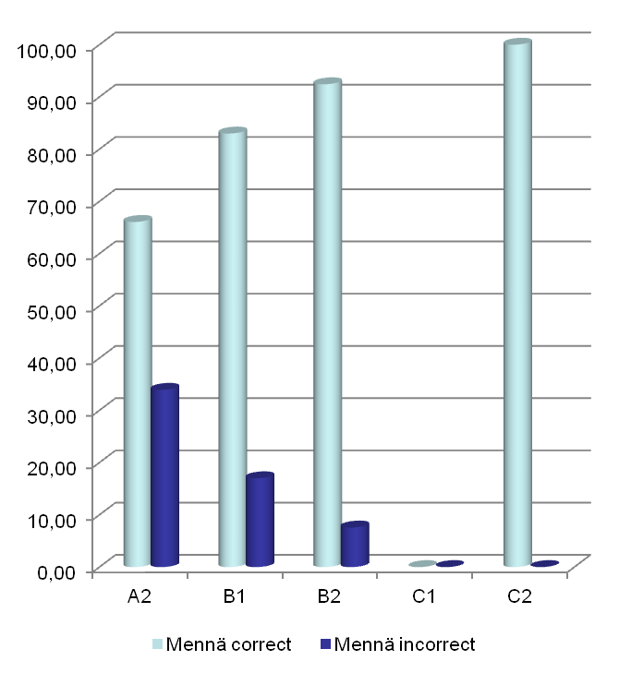
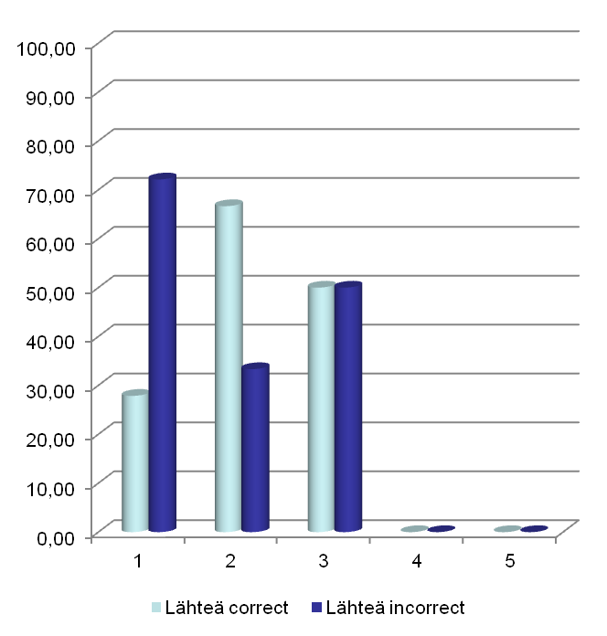
Accuracy on Estonian subcorpus: percentage of correct and incorrect usages per 1000 tokens
Notes:
13

Slide 14
Morphophonological variation of Finnish verb lähteä in Estonian subcorpus
(1) Kello kaksi lähden suomen luennossa, sitten syön.
clock.NOM.SG two go-1SG Finnish-GEN class-INE.SG , then eat-1SG.
‘At two o’clock I’ll go in the Finnish class, then I’ll eat.’
Confusing on consonant gradiation in Estonian subcorpus
lähdön, lähen, lähten, lähtön
Notes:
14

Slide 15
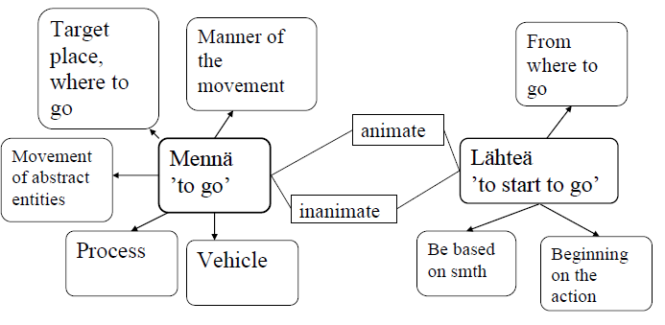
Usage of Finnish verbs mennä and lähteä in native corpus

Slide 16
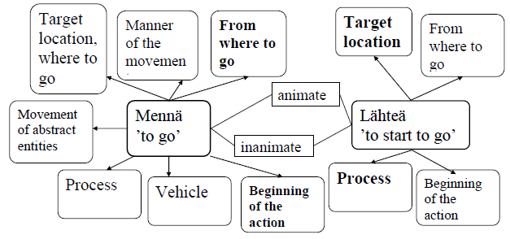
Usage of Finnish verbs mennä and lähteä in Estonian subcorpus

Slide 17
Summary
Slight tendency of overuse of mennä and underuse of lähteä
Usage of mennä remarkably more accurate than usage of lähteä
Mixed use of verbs mennä and lähteä:
mennä in sense of beginning on the action and in sense of from where to go
lähteä in sense of process and target location

Slide 18
Further research
Comparing Estonian subcorpus with multi-source-language subcorpus to explore L1 influence

Slide 19
References
Francescina et al 2006 = Franceschina, F. & Alanen, R., Huhta, A., Martin, M. 2006. A progress report on the Cefling project.
Housen, A. , Kuiken, F. 2009. Complexity, accuracy and fluency in Second Language Acquisition. Applied Linguistics 30 (4), 461-473.
Jantunen, J. H. 2004. Untypical patterns in translations. Issues on corpus methodology and synonymity. A. Mauranen, P. Kujamäki (eds.) Translation Universals. Do they Exists? Amsterdam: John Benjamins, 101−126.
Jarvis, S. 2000. Methodological Rigor in the Study of Transfer: Identifying L1 Influence in the Interlanguage Lexicon. Language Learning 50 (2), 245−309
Jarvis, S. 2010. Comparison-based and detection-based approaches to transfer research. Roberts, L., Howard, M., Ó Laoire, M. & Singleton, D. (eds.). EUROSLA Yearbook 10 Amsterdam: Benjamins, 169−192.
Latomaa, S. 1993. Mitä hyötyä on oppijoiden kielitaustan tuntemisesta? Aalto, E. & Suni, M. (eds.) Kohdekielena suomi. Näkökulmia opetukseen. Korkeakoulujen Kielikeskuksen selosteita 1. Jyväskylä: University of Jyväskylä, 9–31.
Pällin. K, Kaivapalu. A. 2012. Suomen mennä ja lähteä vertailussa: lähtökohtana vironkielinen suomenoppija. Lähivertailuja 22, Muikku-Werner, P., Jantunen, J. H., Sepper, M.-M. (eds.), Lähivertailuja 22, 287−323.
Ringbom, H. 1987. The Role of the First Language in Foreign Language Learning. Clevedon: Multilingual Matters LTD.
ICLFI, see http://WWW.oulu.fi.hutk/stuvi/oppijankieli/

Slide 20
Takk
Tänan
Kiitos

